Slide 1
How do consumers make purchasing decisions?
Predictive Data Analysis Using Multinomial Logistic Regression

Slide 2
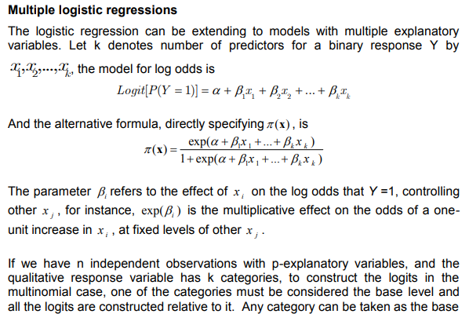
MULTINOMIAL LOGISTIC REGRESSION MODELLING (EXCERPT FROM EL-HABIL 2012 pp.273)

Slide 3
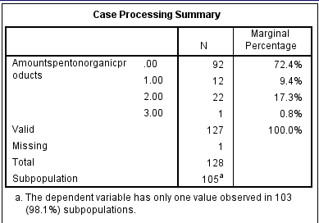
MULTINOMIAL LOGISTIC REGRESSION
The number of valid observation used in this model is 127 distributed among the four categories.
The marginal percentage column shows the proportion of valid observation found in each response variable groups, 7
2.4% of the valid case spend between 0 -5, 9.4% spend between 5.01 -15, 17.3% spend between 15.01 – 30 and 0.8% spend between 30.01 and 50.

Slide 4
The sub population of the data consists of one combination of the explanatory variables specified for this model.
In this model, there are 127 combinations that appear in the data and 105 of these are composed of records with the same response variable categories.
Missing represent missing data of the response or any of explanatory variables
category of people that did not select any response are not valid decisions and it is considered as missing and this will not affect the final results (Moorman and Carr 2008).

Slide 5
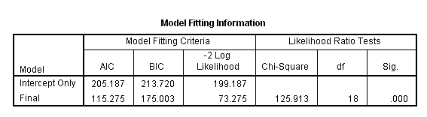
In this model, AIC and BIC and -2log likelihood are very close indicating that the model is optimal. This guarantee that the model fits well (Agresti, 2007 ). The chi-square statistic is statistically significant at 0.000.
The null hypothesis is that all parameters of that effect are 0. The Likelihood ratio tests shows that all the explanatory variables were significant but the effect as a result of their contribution is different and not the same with each other.

Slide 6
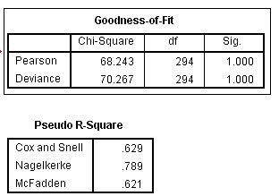
The null hypothesis is that all parameters of that effect are 0. The Likelihood ratio tests shows that all the explanatory variables were significant but the effect as a result of their contribution is different and not the same with each other.

Slide 7
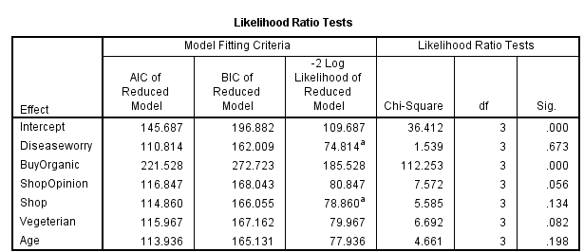
AIC (Akaike Information Criterion) and BIC (Bayesian Information Criterion) judges a model by how close it fitted values tend to be to the true expected values.
The difference in -2 log-likelihoods between the final model and a reduced model. The reduced model is formed by omitting an effect from the final model. Using the likelihood ratio test , only the variable BuyOrganic was statistically significant.

Slide 8
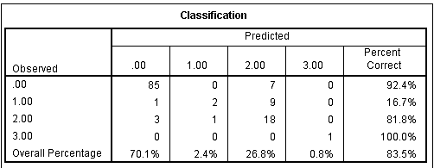
CLASSIFICATION
The classification overall percentage computed by SPSS is given as while the by chance proportional accuracy criterion is given as 83.5% which implies that the model is accurate.

Slide 9
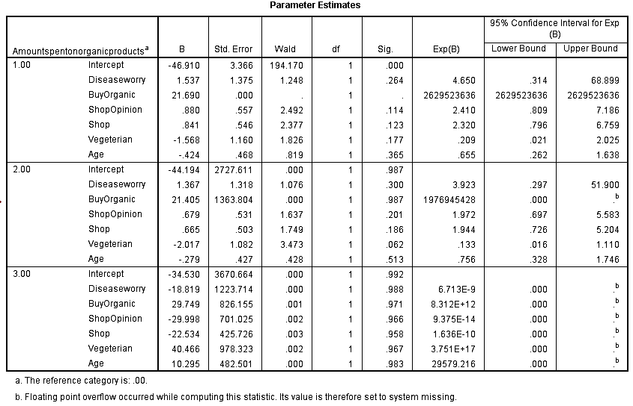
PARAMETER ESTIMATION

Slide 10
PREDICTION USING MLR MODEL
For the application of the model, randomly selected responses that have higher frequency were used in predicting from which groups to classify it. The model consists of two equations to estimate the three response probabilities (_{π0, π1, π2, π3}) by using equation (1), (2), and (3).
Explanatory variables | ( 5 -15) | (15.01 – 30) | (30.01 – 50)
Buy Organic Product or Not | 1 | 2 | 3
Shop Opinion | 1 | 2 | 3
Shop | 1 | 2 | 3
Age | 1 | 2 | 3

Slide 11
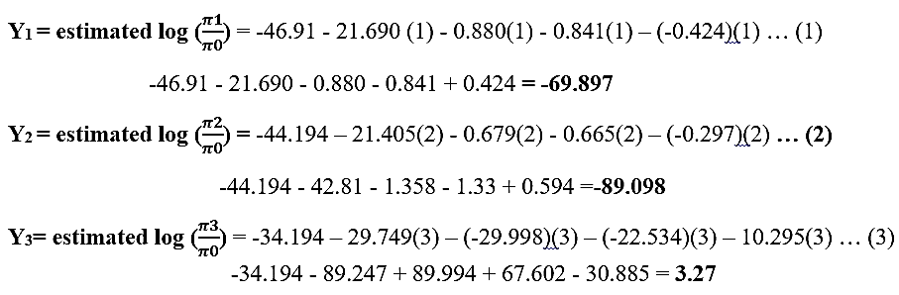
PREDICTION USING MLR MODEL

Slide 12
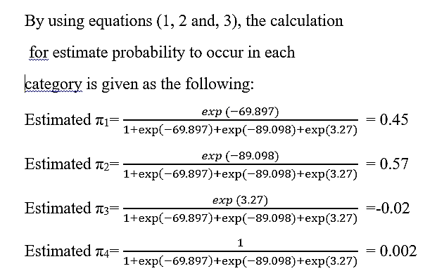
PREDICTION USING MLR MODEL…Cont’d

Slide 13
FINDINGS
The baseline category used is amount spent between 0 and 5. The research aims to increase the amount spent on organic product by customers.
The prediction result shows a probability of 0.45 (45%) for customers to spend the amount between 5.01 – 15 in the purchase of organic products.
Also, there is a probability of 0.57 (57%) for customers to spend the amount between 15.01 – 30 in the purchase of organic products.
Also, there is a probability of -0.02 (-2%) for customers to spend the amount between 30.01 – 50 in the purchase of organic products.
Based on the chi-square value, there is a significant relationship between amount spent on organic product, buy organic product or not and shop opinion.

Slide 14
RECOMMENDATION
Business owners should consider improving the satisfaction they offer to customers by 90% and increase the amount spent on organic products instead of opening new shops .
Advertisement with emphasis on the benefit of organic product should be done to attract more customers and thus increase the amount spent on organic product.

Slide 15
REFERENCES
EL-HABIL M. (2012). An Application on Multinomial Logistic Regression Model. Pakistan Journal of Statistics and Operation Research; (8)(2) pp271-291.
Moorman, S.M., and Carr, D. (2008). Spouses Effectiveness as End-of-Life Health Care Surrogates: Accuracy, Uncertainty, and Errors of Overtreatment or Undertreatment. The Gerontological Society of America.48:811

Slide 16
THANK YOU

